Slide 1
Digital Portfolio
STUDENT NAME: AS.shaikh zayed
REGISTER NO AND NMID: asanm11411424ucsc065
DEPARTMENT: COMPUTER SCIENCE
COLLEGE: Dr S RAMADOSS ARTS AND SCIENCE COLLEGE
UNIVERSITY: ANNAMALAI UNIVERSITY

Slide 2
PROJECT TITLE
MY POTFOLIO

Slide 3


AGENDA
Problem Statement
Project Overview
End Users
Tools and Technologies
Portfolio design and Layout
Features and Functionality
Results and Screenshots
Conclusion
Github Link
3/21/2024 Annual Review

Slide 4

PROBLEM STATEMENT
Students need an effective and visually appealing online portfolio to showcase their skills, projects, experience, and contact information. This portfolio must be accessible on various devices and provide a professional web presence.

Slide 5

PROJECT OVERVIEW
The project is to create a responsive student portfolio website using HTML (for structure), CSS (for styling including colors, fonts, selectors, box model, layout, media queries), and JavaScript (for interactivity). It will include sections such as About, Skills, Experience, Projects, and Contact.

Slide 6

WHO ARE THE END USERS?
- Students and fresh graduates looking to
present their skills and projects.-
Recruiters and potential employers who evaluate candidates based on online portfolios.-
Educators and mentors who want to review student work easily.

Slide 7

TOOLS AND TECHNIQUES
TOOLS:
Code editor (e.g., VS Code), modern web browsers, image editor for photos.
TECHNIQUES:
Use HTML5 semantic tags for structure (header, section, article, footer).
Apply CSS for colors, fonts, layouts (flexbox, grid), and responsive design with media queries.
Use JavaScript for interactive elements like navigation menus, tabs for skills/experience, and contact forms.

Slide 8
POTFOLIO DESIGN AND LAYOUT
Clean, minimalistic design with clear navigation.- Header with logo and menu.
About section with student image and bio.
Tabbed sections for skills, education, experience.
Portfolio section showcasing projects with images and descriptions.
8

Slide 9
FEATURES AND FUNCTIONALITY
Responsive navigation menu with mobile hamburger toggle (JavaScript).
Tabbed interface for skills, experience, and education (JavaScript).
Hover effects on project images and service cards (CSS transitions).
Contact form sending data (JavaScript), optionally integrated with Google Sheets.

Slide 10
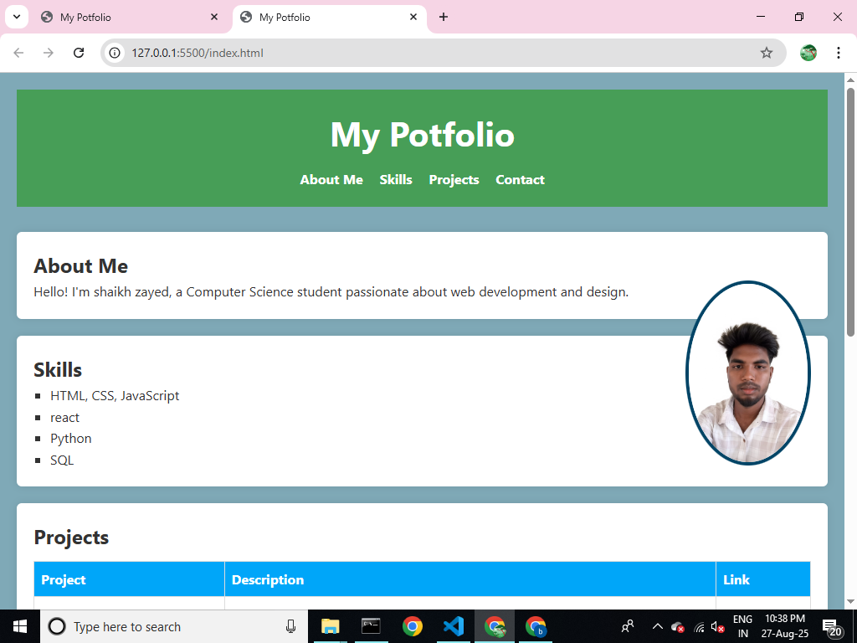
RESULTS AND SCREENSHOTS
3/21/2024 Annual Review
10

Slide 11
CONCLUSION
Creating a student portfolio using HTML, CSS, and JavaScript provides a valuable skill-building project combining design and web development. The portfolio enables students to professionally present their achievements to potential employers and creates an interactive, responsive user experience. Proper use of web standards, styling with CSS including me
Github link:
https://github.com/shaikhzayed9626/zayed.git
11

